Slide 1
Introducing…
The Faculty of Political Science

Slide 2
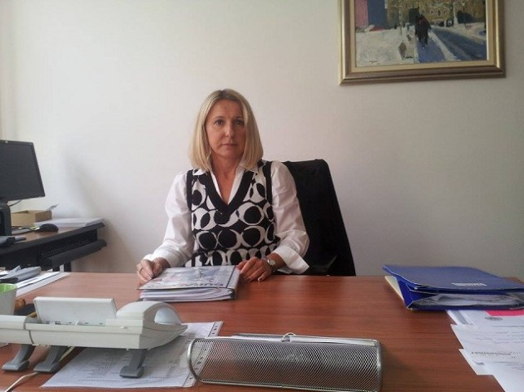
Lidija Kos-Stanišić, Full Professor and Dean

Slide 3
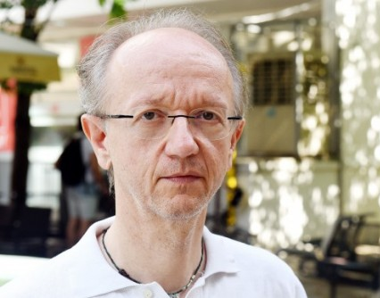
Zoran Kurelić, Full Professor With Tenure and Dean

Slide 4
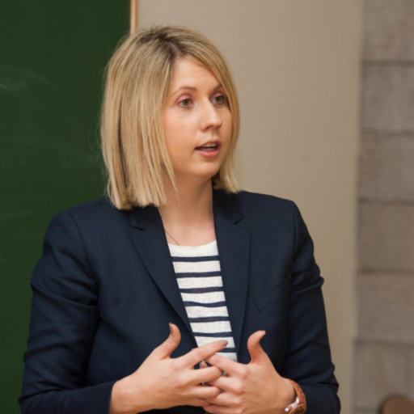
Đana Luša, Assistant Professor and Vice-Dean for Science and International Cooperation

Slide 5
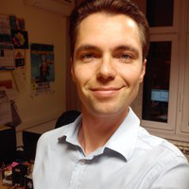
Zlatan Krajina, Assistant Professor and Vice-Dean for Science and International Cooperation
Media and the City
Master studies – 7 ECTS
First meeting: Wednesday, 03.10.
08:30 – 11:45
Room: Seminar III (3rd floor)
Email: zlatan.krajina@fpzg.hr

Slide 6
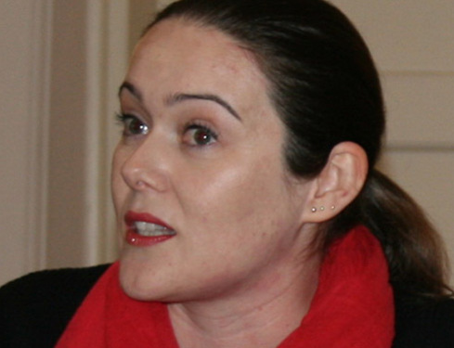
Marjeta Šinko, PhD
Comparative Political Systems
Bachelor studies – 5 ECTS
First meeting: Thursday, 25.10.
19:00 – 20:30
Room: F3 (3rd floor, Fabkovićeva street)
Email: marjeta.sinko@fpzg.hr

Slide 7
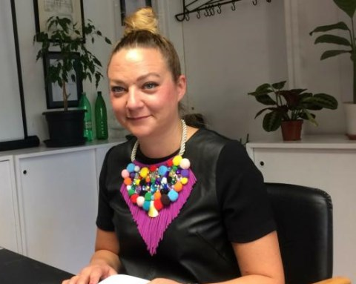
Marta Zorko, Associate Professor
Contemporary Geopolitical Issues
Bachelor studes – 5 ECTS
First meeting: Wednesday, 31.10.
19:00 – 20:30
Room: D (2nd floor)
Email: mzorko@fpzg.hr

Slide 8
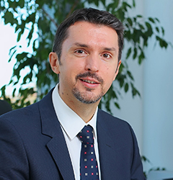
Igor Vidačak, Associate Professor
EU Enlargement and Europeanization of Croatia
Bachelor studies – 5 ECTS
First meeting: Friday, 05.10.
12:00 – 15:15
Room: C (2nd floor)
Email: igor.vidacak@fpzg.hr

Slide 9
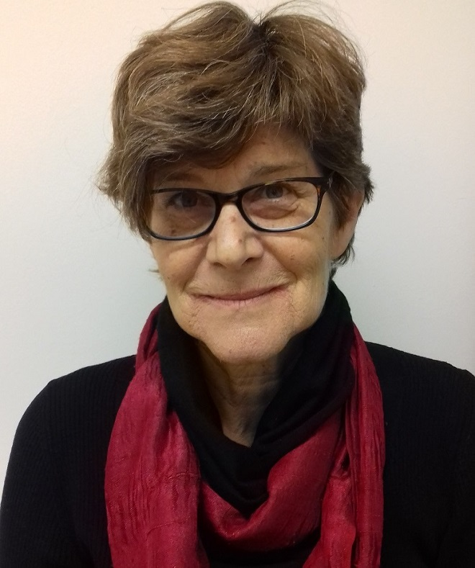
Gordana Vilović, Full Professor and Vice-Dean for Academic and Student Affairs
Media and Child Rights
Bachelor studies – 5 ECTS
First meeting: Tuesday, 16.10.
16:30 – 18:00
Room: 18 (4th floor)
Email: gordana.vilovic@fpzg.hr

Slide 10
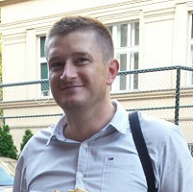
Dario Nikić Čakar, Assistant Professor and ECTS Coordinator
Political Leadership and Democracy
Bachelor studies – 5 ECTS
First meeting: Monday, 22.10.
08:30 – 10:00
Room: Seminar I (3rd floor)
Email: dario.nikic@fpzg.hr

Slide 11
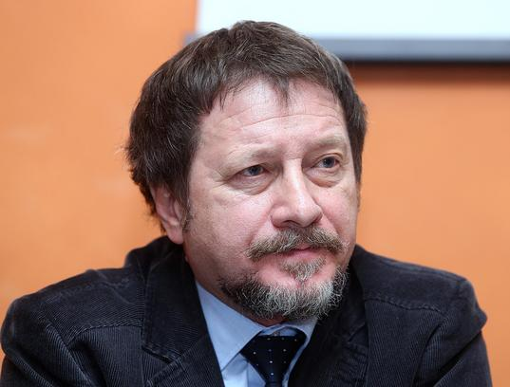
Tihomir Cipek, Full Professor With Tenure
Theories of Nationalism
Bachelor studies – 5 ECTS
First meeting: Wednesday, 03.10.
12:00 – 15:15
Room: Seminar V (4th floor)
Email: tcipek@fpzg.hr

Slide 12
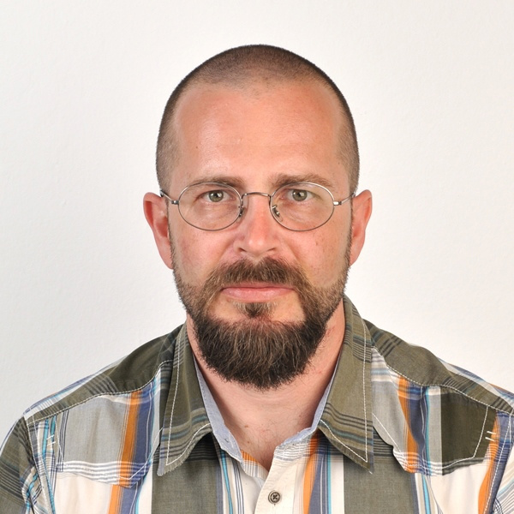
Nebojša Blanuša, Associate Professor
Theories of Nationalism
Bachelor studies – 5 ECTS
First meeting: Wednesday, 03.10.
12:00 – 15:15
Room: Seminar V (4th floor)
Email: nblanusa@fpzg.hr

Slide 13
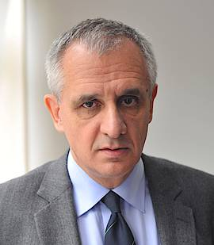
Nenad Zakošek, Full Professor With Tenure
Democracy and Economic Development
Master studies – 7 ECTS
First meeting: Thursday, 04.10.
15:30 – 18:45
Room: F3 (3rd floor
Fabkovićeva street)
Email: nenad.zakosek@fpzg.hr

Slide 14
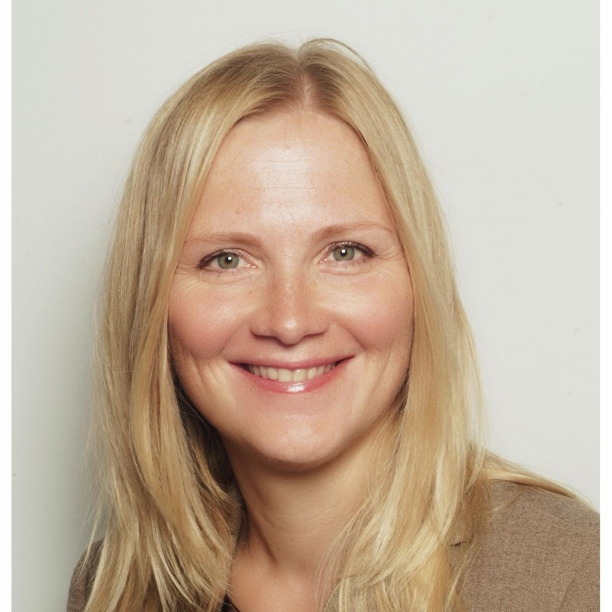
Dagmar Radin, Associate Professor
Health Policy and Systems
Master studies – 7 ECTS
First meeting: Wednesday, 03.10.
15:30 – 18:45
Room: Seminar V (4th floor)
Email: dradin@fpzg.hr

Slide 15
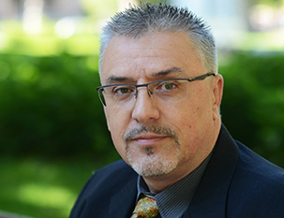
Boris Havel, Assistant Professor
Religion and Politics in the Middle East
Master studies- 7 ECTS
First meeting: Thursday, 04.10.
12:00 – 15:15
Room: D (2nd floor)
Email: boris.havel@fpzg.hr

Slide 16
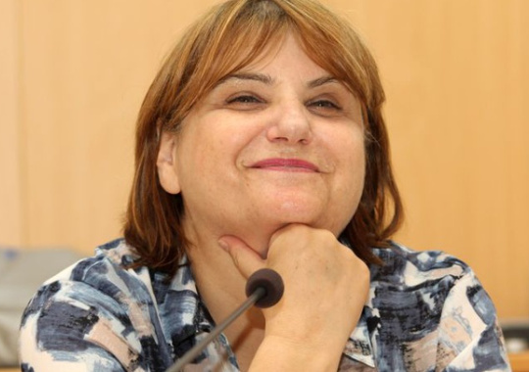
Tena Perišin, Associate Professor
Television News in Multimedia Environment
Master studies – 7 ECTS
First meeting: Monday, 01.10.
12:00 – 15:15
Room: D (2nd floor)
Email: tena.perisin@fpzg.hr

